Slide 1
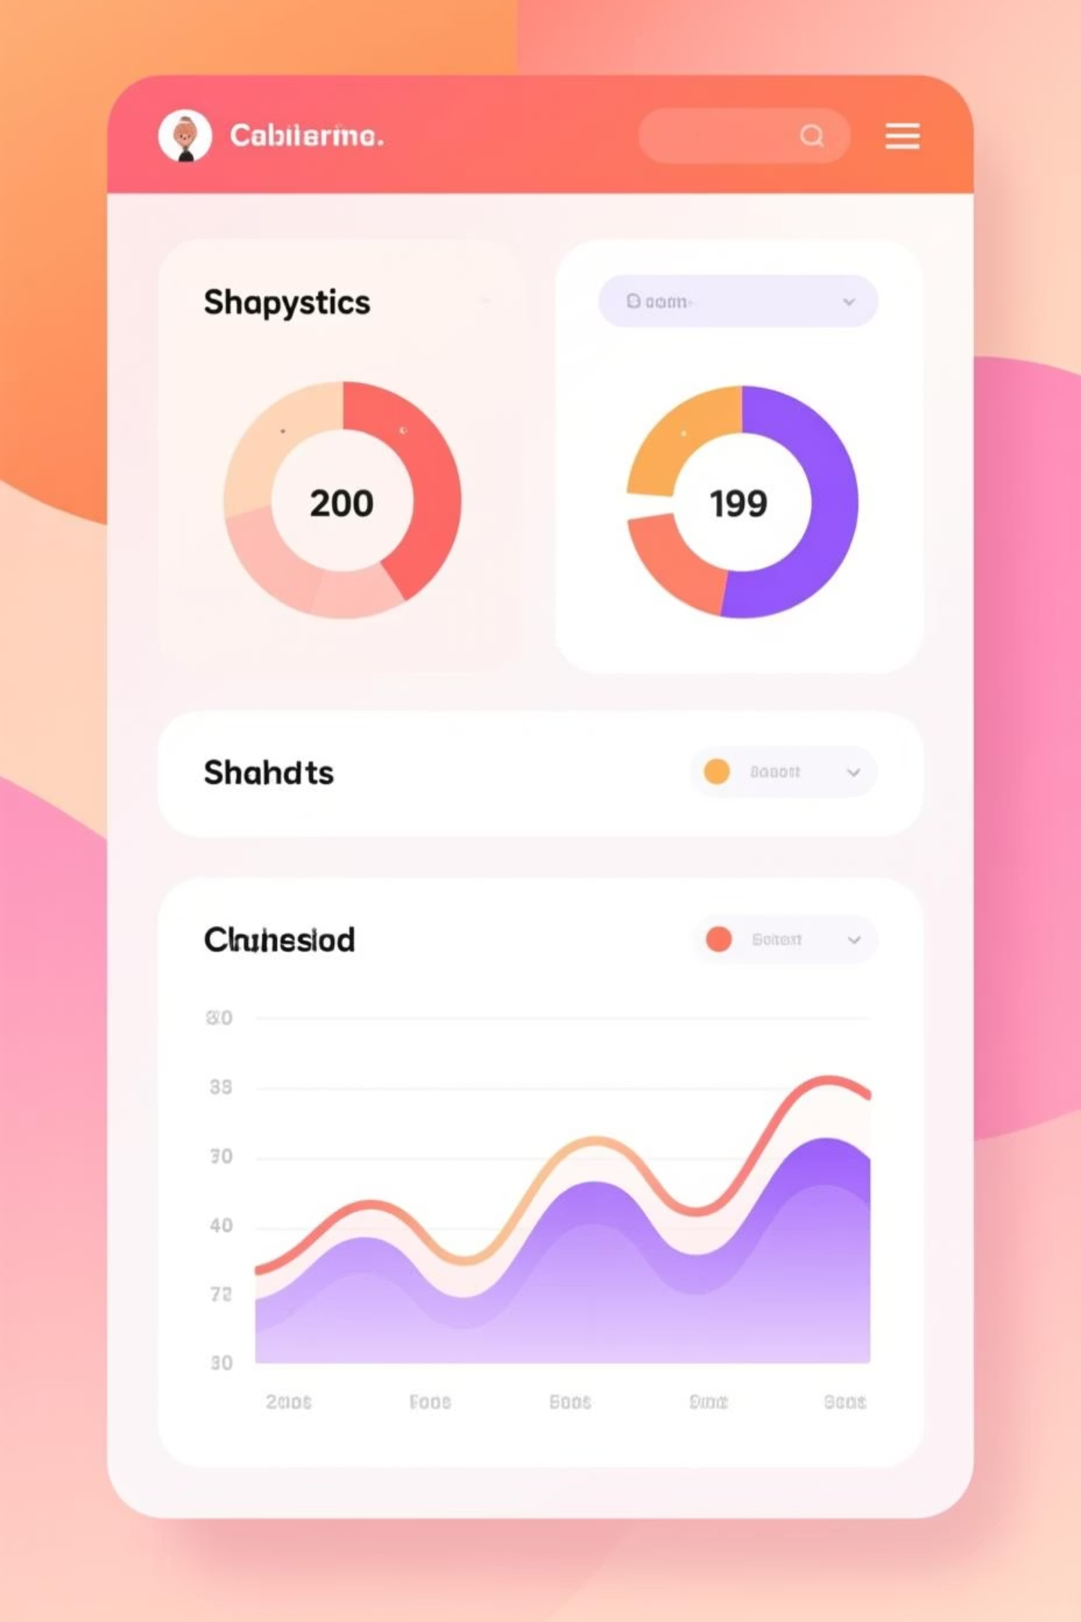
Customer Shopping Behavior Analysis
Analyzing 3,900 customer transactions to unlock shopping patterns and drive smarter business decisions

Slide 2
Dataset at a Glance
3,900
18
37
Total Transactions
Data Columns
Missing Values
Customer purchases analyzed
Features tracked per transaction
In Review Rating column only
Customer Details
Purchase Details
Shopping Behavior
Age, Gender, Location
Item, Category, Amount
Discounts & Promo Codes
Subscription Status
Season, Size, Color
Review Rating, Shipping Type

Slide 3
Data Preparation in Python
01
02
03
Data Loading & Exploration
Missing Data Handling
Column Standardization
Imported dataset using pandas, checked structure with df.info() and summary statistics
Imputed 37 missing Review Ratings using median rating per product category
Renamed columns to snake_case for better readability
04
05
Feature Engineering
Database Integration
Created age_group and purchase_frequency_days columns
Connected to MySQL and loaded cleaned data for SQL analysis

Slide 4
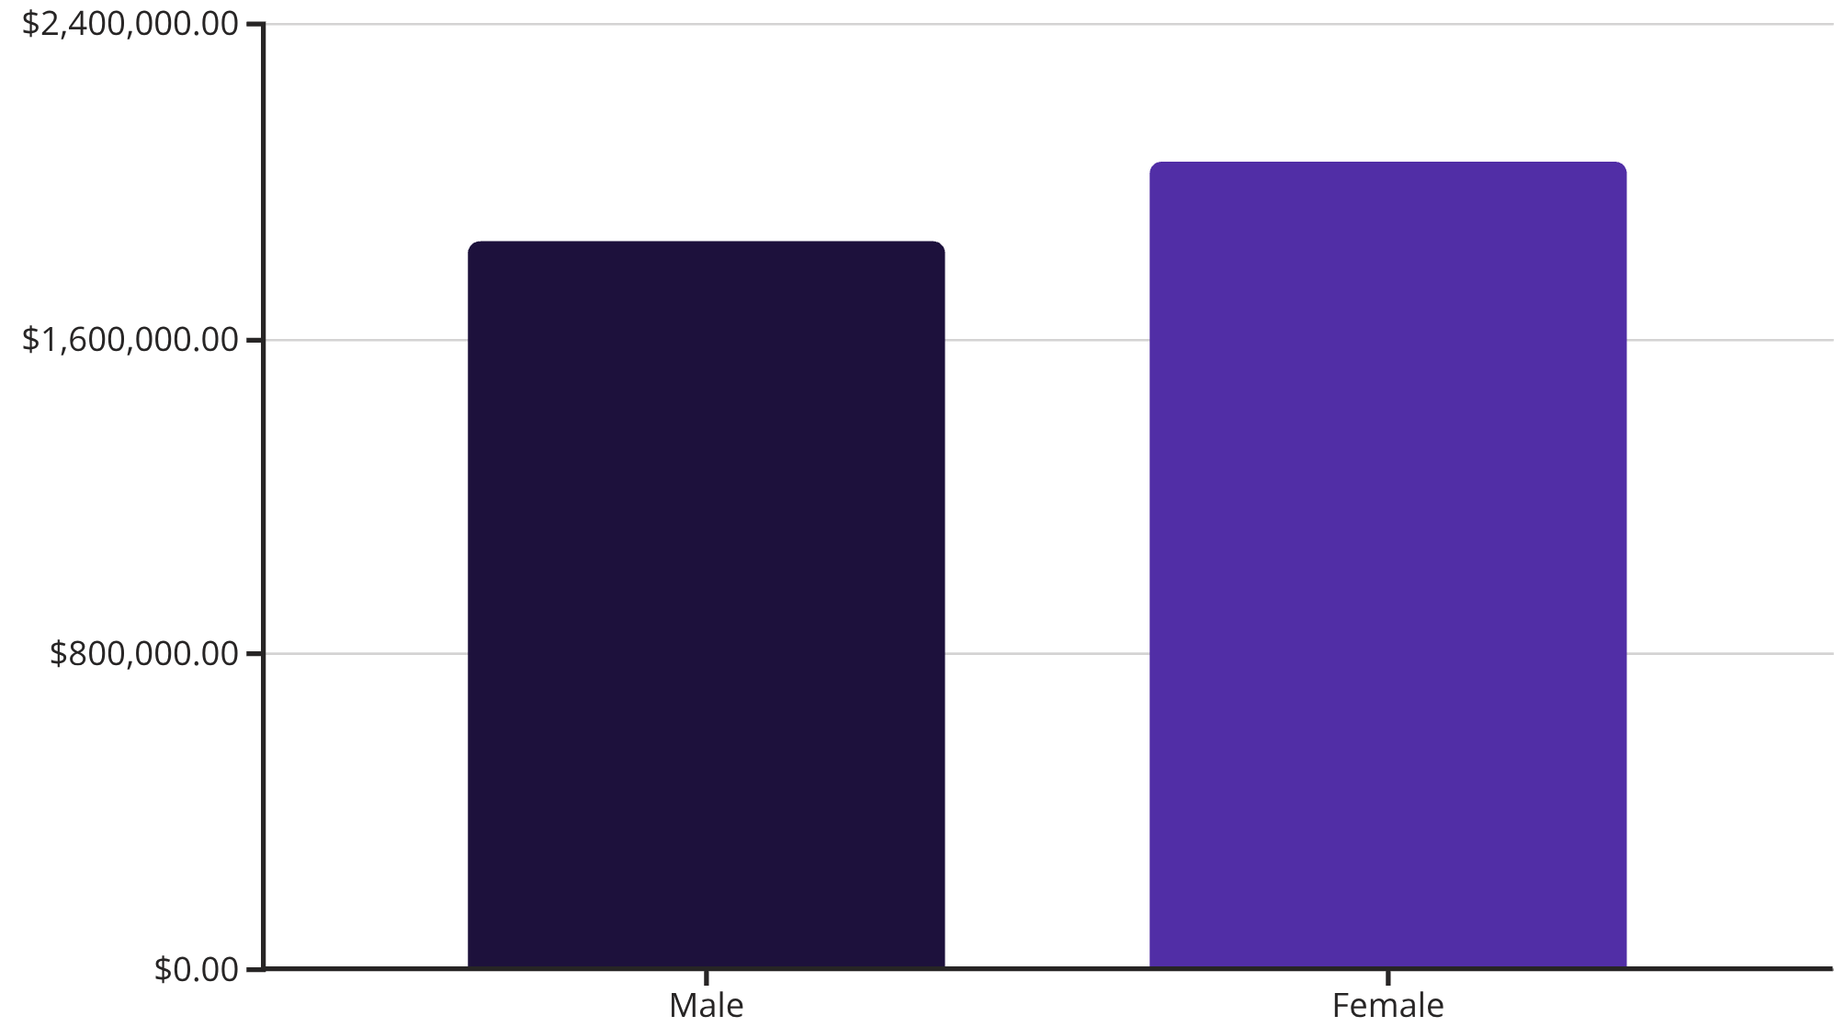
Revenue Insights by Gender
Gender Revenue Comparison
Female customers generate slightly higher total revenue than male customers across all transactions

Slide 5
Top-Rated Products Drive Satisfaction
1
2
3
Blouse
Jewelry
Pants
Highest average rating
Second highest rating
Third highest rating
4
5
Shirt
Dress
Fourth highest rating
Fifth highest rating

Slide 6
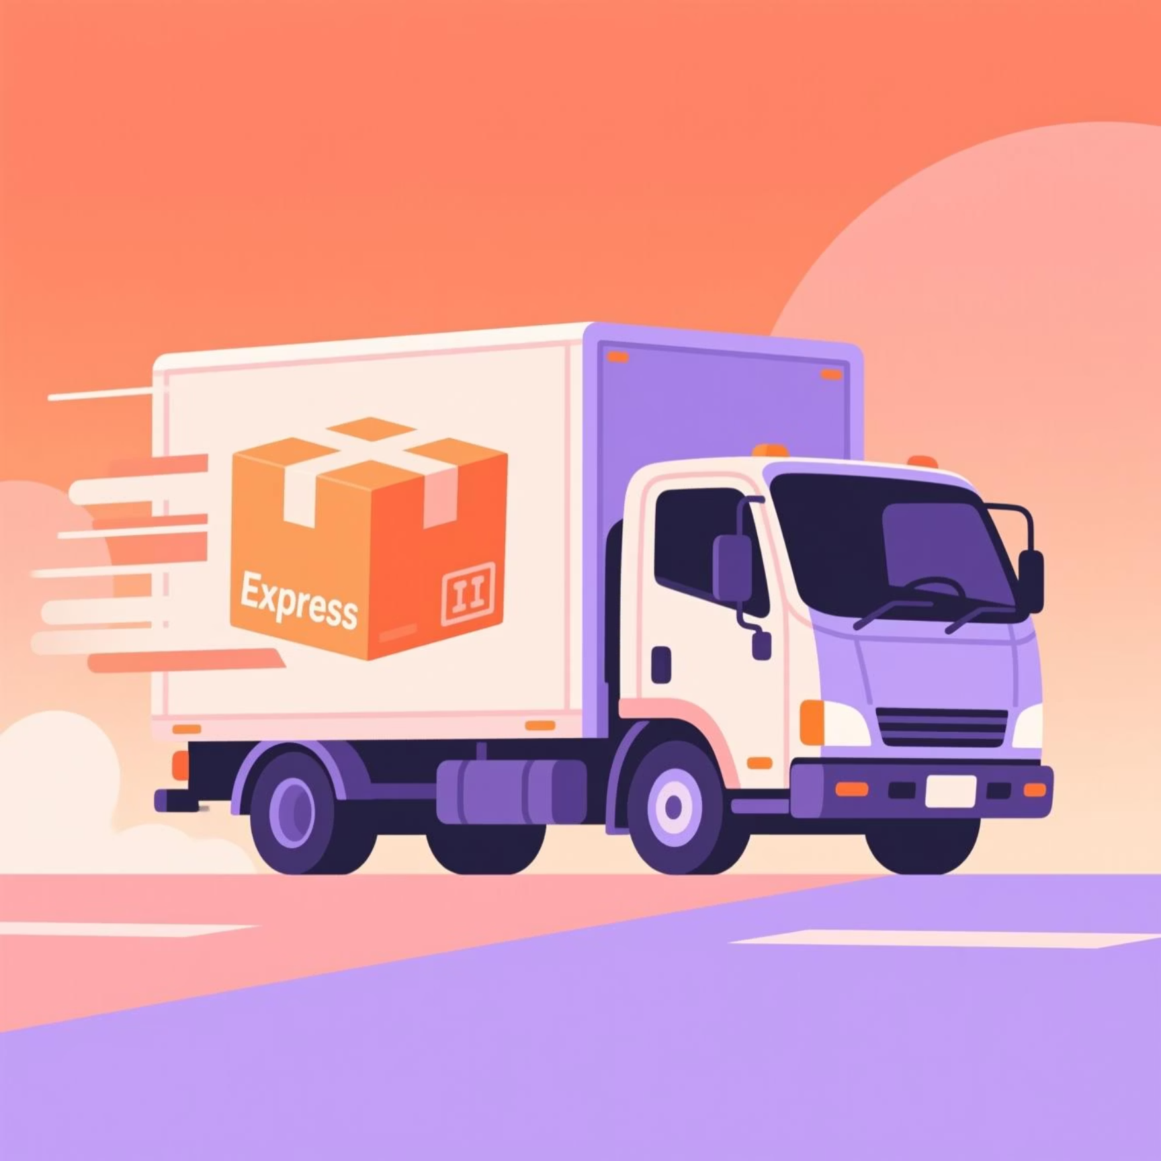

Shipping & Subscription Patterns
Shipping Type Impact
Subscriber Value
Express shipping customers spend more on average than Standard shipping users
Subscribers generate higher average spend and total revenue compared to non-subscribers

Slide 7
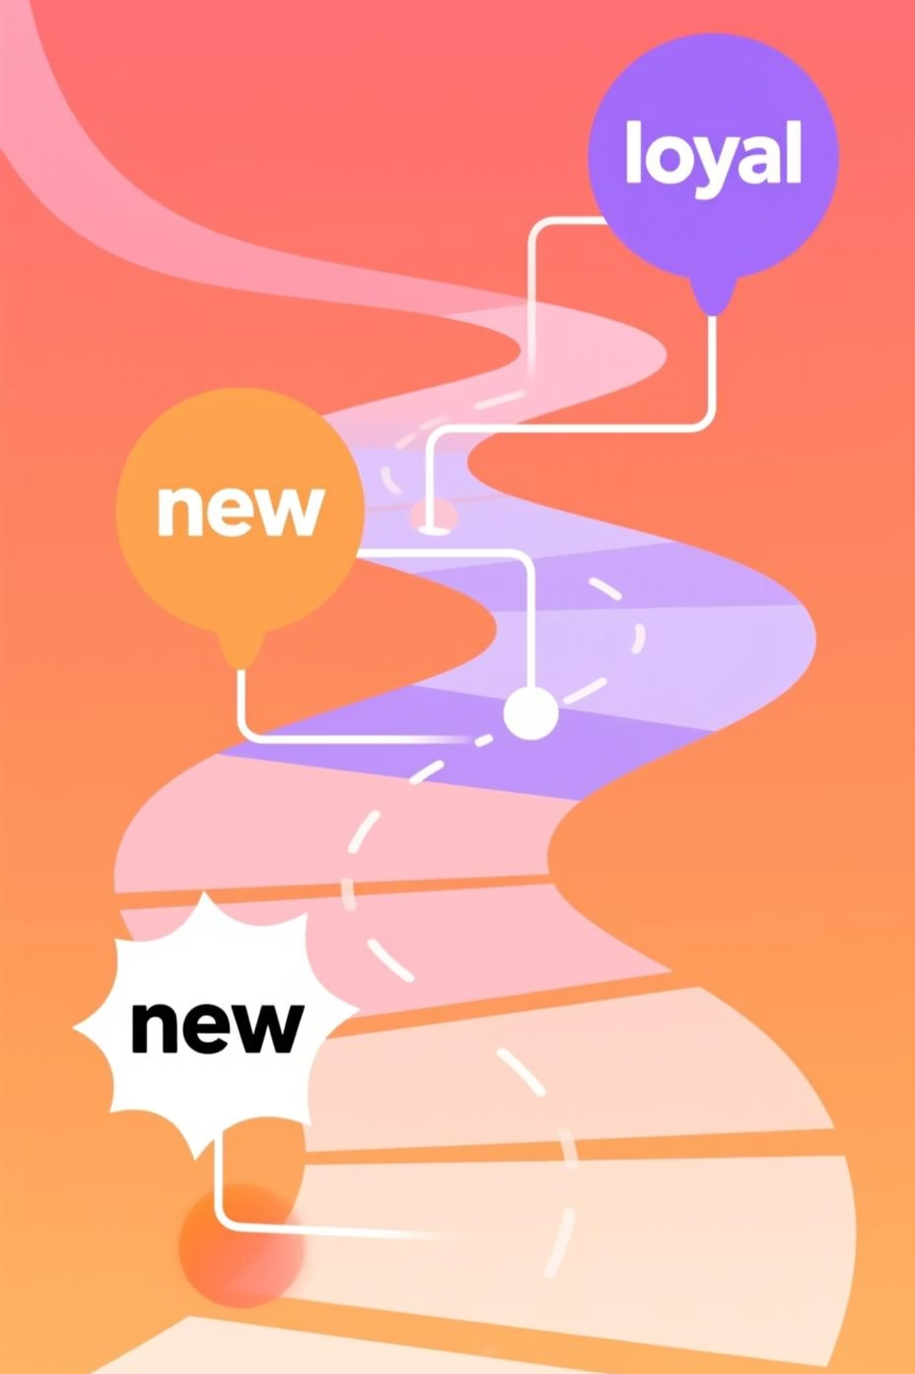
Customer Segmentation Analysis
New Customers
Returning Customers
First-time buyers exploring the catalog
2-5 previous purchases, building loyalty
Loyal Customers
5+ purchases, highest lifetime value
Customers with more than 5 purchases show significantly higher subscription rates

Slide 8
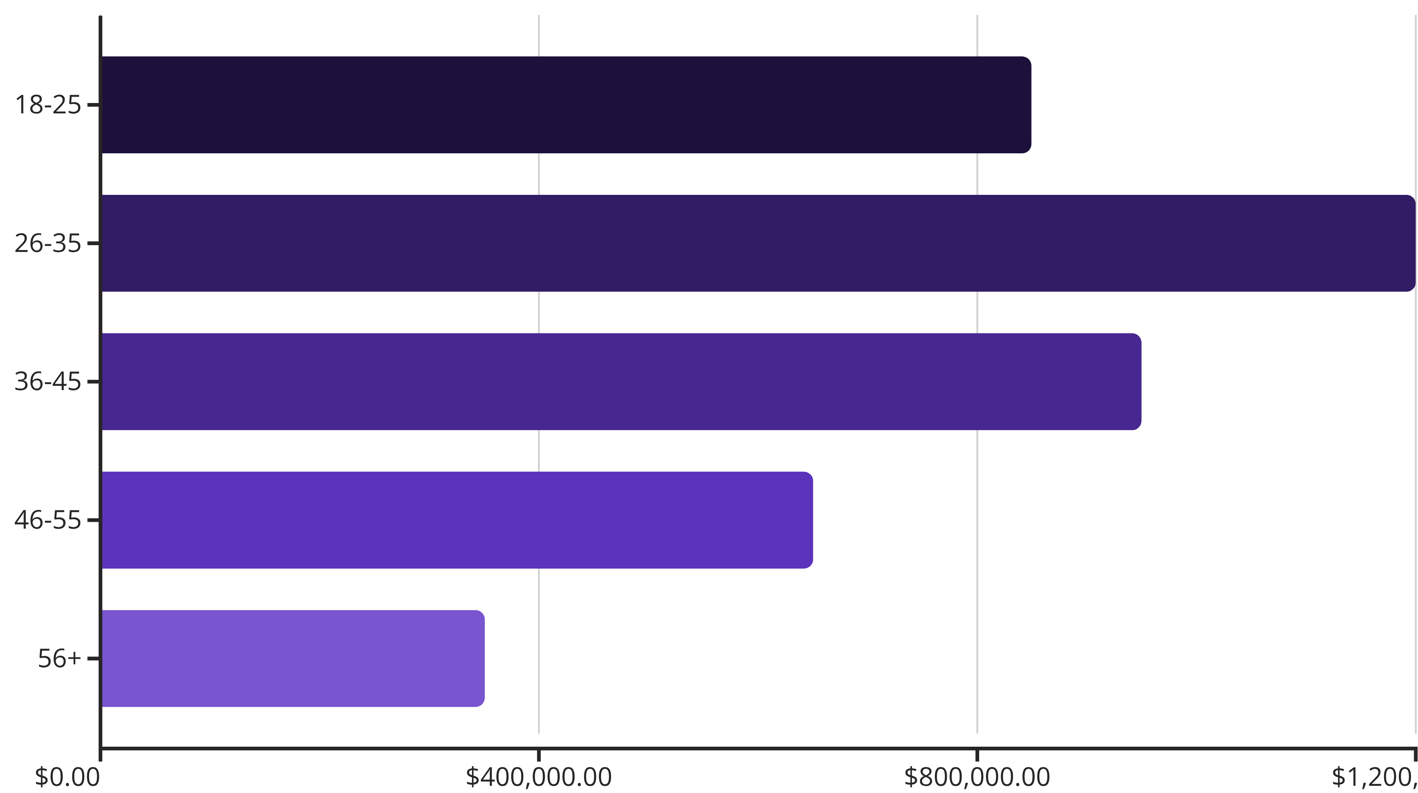
Revenue by Age Group
26-35 age group drives the highest revenue contribution

Slide 9

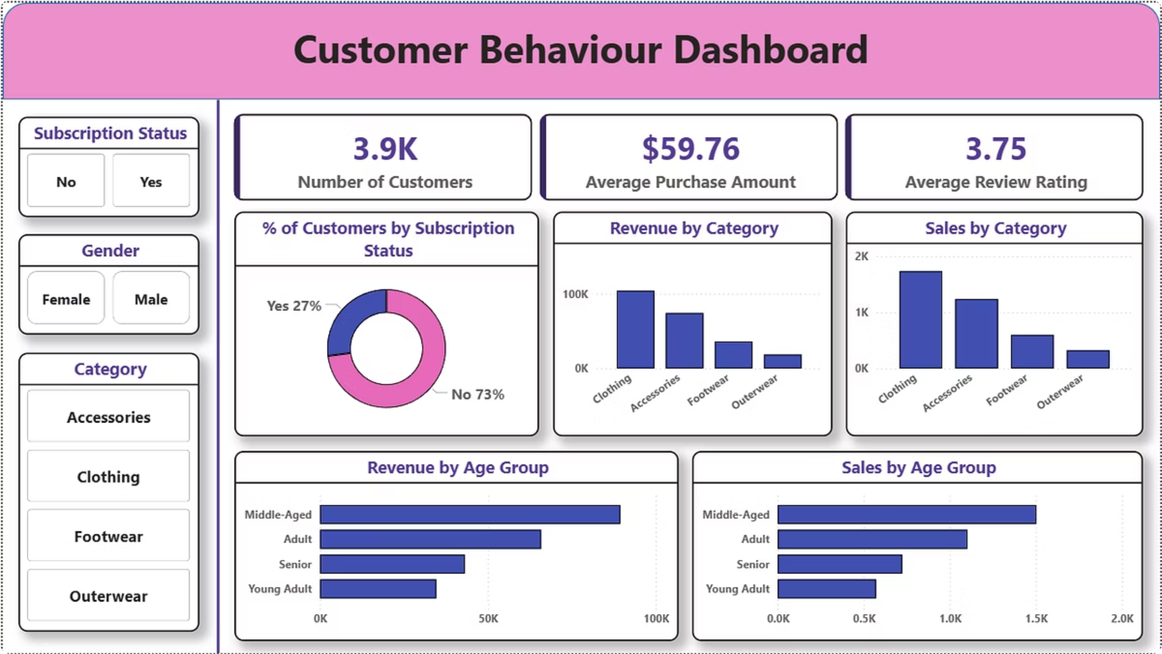

Interactive Power BI Dashboard
Visual Insights
Interactive charts reveal spending patterns and trends
Dynamic Filtering
Slice data by category, age, location, and more
Actionable Metrics
KPIs drive strategic business decisions

Slide 10





Strategic Recommendations
Boost Subscriptions
Highlight exclusive benefits to convert more users
Loyalty Programs
Reward repeat buyers to build long-term relationships
Optimize Discounts
Strategic discounting improves sales without hurting margins
Product Positioning
Feature top-rated items in marketing campaigns
Targeted Marketing
Focus on high-revenue age groups and express shipping users

